Slide 1
IBM AICTE PROJECT
TRAVEL AI AGENT
Presented By: IBM SkillsBuild Student name : Thulasidhar Reddy
College Name & Department : VIT VELLORE

Slide 2
OUTLINE
Problem Statement
Technology used
Wow factor
End users
Result
Conclusion
Git-hub Link
Future scope
IBM Certifications

Slide 3
PROBLEM STATEMENT
Planning a trip can be time-consuming and overwhelming, especially when users must search for personalized travel itineraries, budget estimations, and location-specific tips across multiple platforms. There is a need for an intelligent assistant that can simplify the travel planning process by generating personalized itineraries, estimating costs, and offering travel advice based on user preferences.
This project aims to develop an AI-powered Travel Planner Agent using IBM Watsonx.ai that interacts with users in natural language, collects key trip preferences (destination, number of days, budget), and generates a tailored travel plan. Due to platform limitations in student/SkillsBuild accounts, AI tools like Python were simulated through prompt engineering using the LangGraph + ReAct architecture.

Slide 4
TECHNOLOGY USED
IBM Watsonx.ai (LangGraph + ReAct)
Granite LLM (Natural Language Generation)
Natural Language Processing (NLP)
Prompt Engineering
Python (logic simulation)
IBM Cloud Lite Services
Jupyter Notebook

Slide 5
IBM CLOUD SERVICES USED
IBM Cloud Watsonx AI Studio
IBM Cloud Watsonx AI runtime
IBM Cloud Agent Lab
IBM Granite foundation model

Slide 6
WOW FACTORS
AI-powered personalized travel planning
Uses IBM Granite LLM for natural conversation
Works without external tools — logic simulated via prompts
Built with LangGraph + ReAct architecture
Budget estimation & itinerary suggestions in real-time
Designed for low-resource cloud environment (Lite tier)
Minimal UI, maximum impact – beginner-friendly & fast

Slide 7
END USERS
Travel Enthusiasts needing quick plans
Busy professionals with no time for research
Students & solo travelers planning low-budget trips
Anyone needing AI-driven trip suggestions instantly

Slide 8
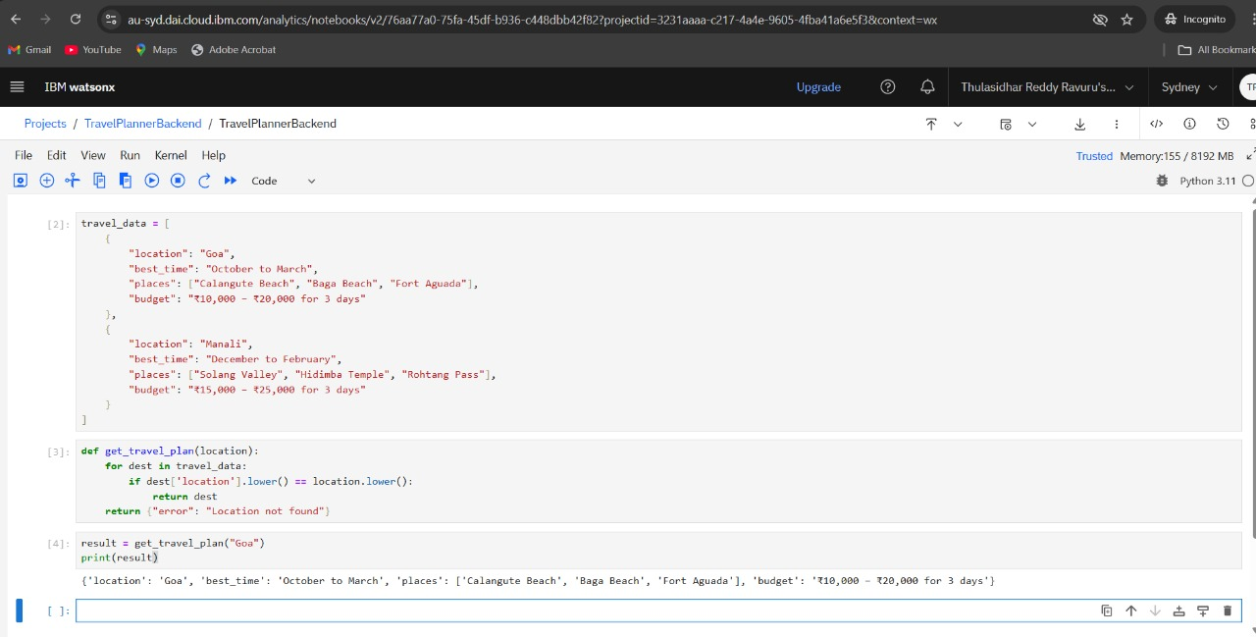
RESULTS
Backend Logic:

Slide 9
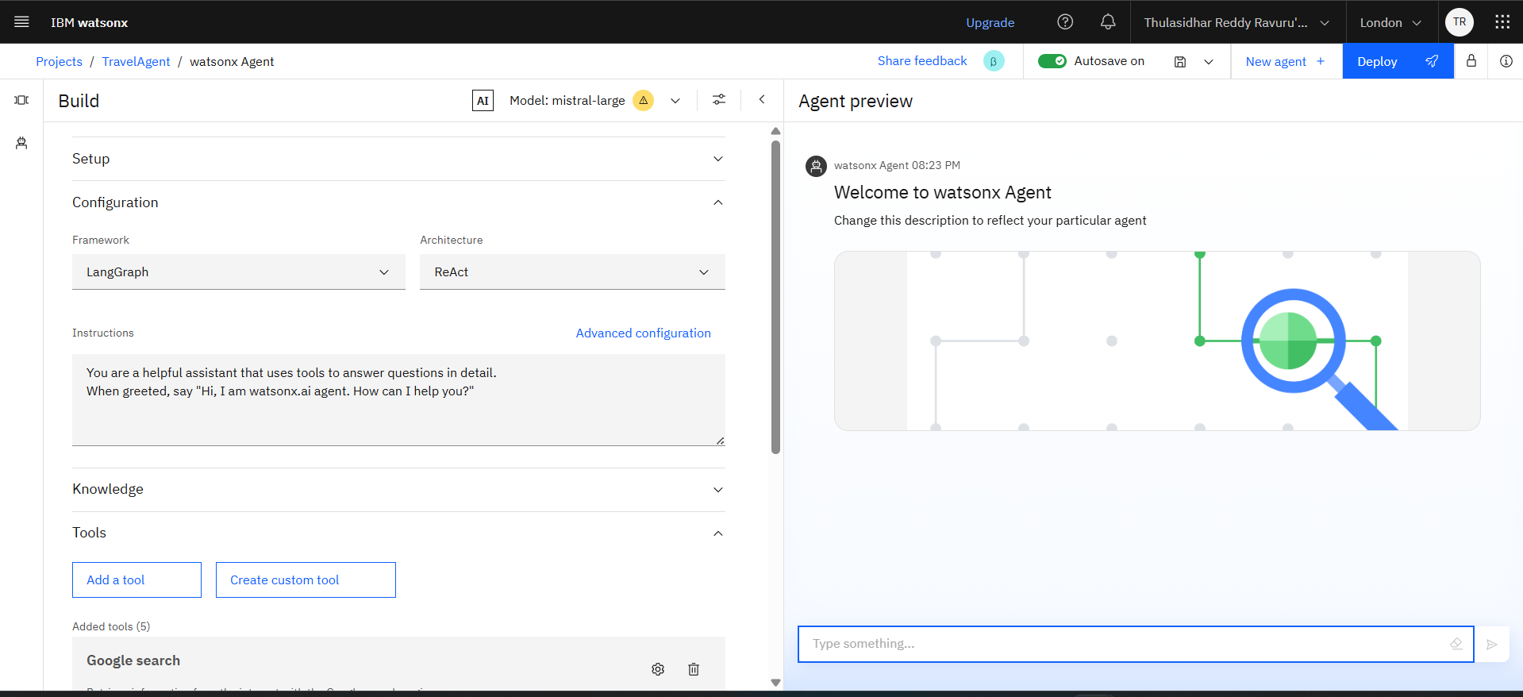
RESULTS

Slide 10
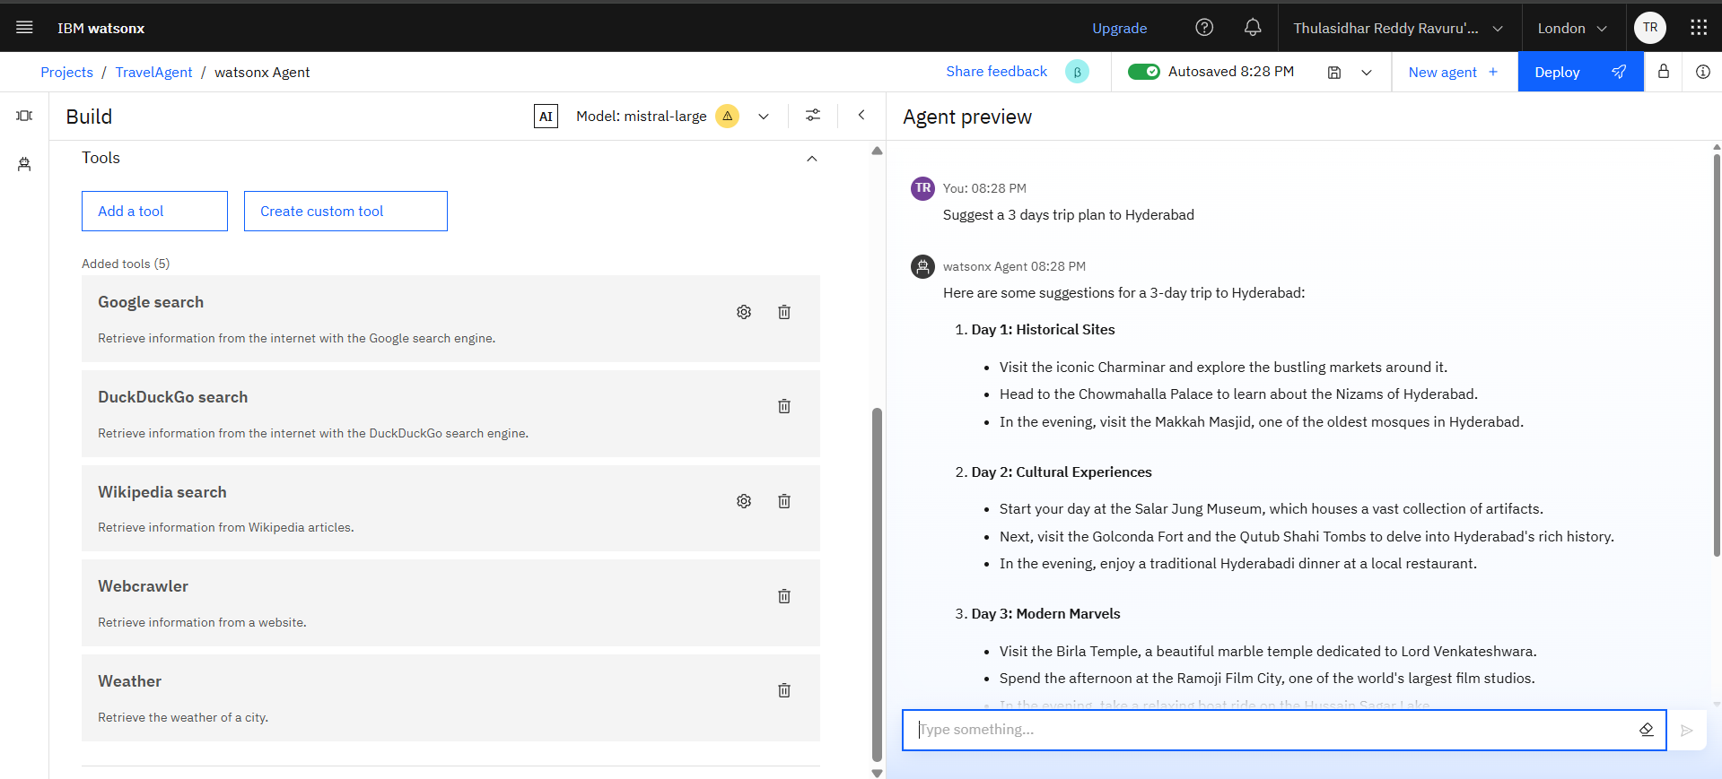
RESULTS

Slide 11
CONCLUSION
The agent can generate reports, suggest hypotheses, and even draft sections of research papers.
It saves time by automating repetitive tasks like citation management and data extraction.
Research Agents enhance efficiency, accuracy, and innovation in both academic and industrial R&D.

Slide 12
GITHUB LINK
GitHub Link: https://github.com/Thulasi128/TravelPlanningAIAgent

Slide 13
FUTURE SCOPE
Multilingual Research Support
Voice-Activated Research Assistant
Real-Time Collaboration Features
Research Gap and Novel Topic Identification
Integration with Publishing Platforms
AI-Assisted Paper Drafting

Slide 14
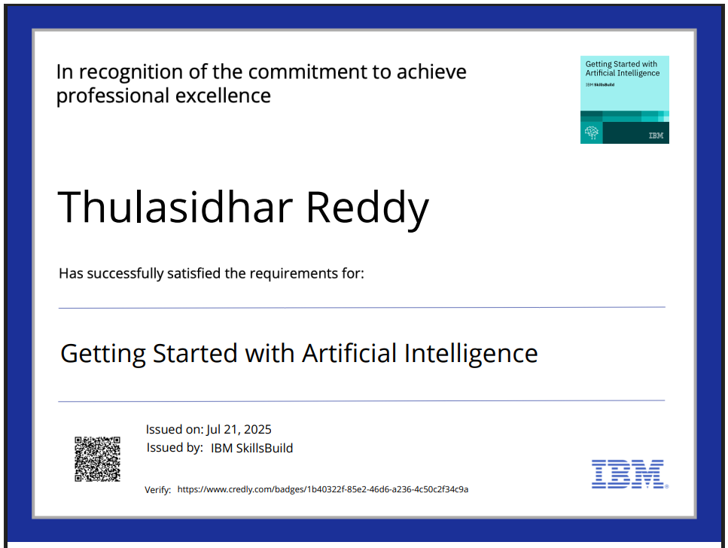
IBM CERTIFICATIONS

Slide 15
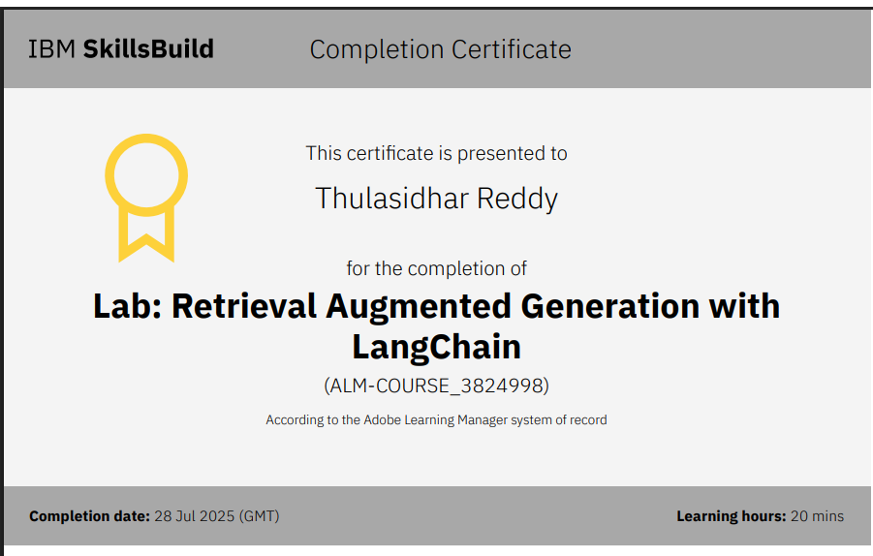

Slide 16
THANK YOU

